Slide 1
DATA COMMUNICATION AND COMPUTER NETWORKS

Slide 2
INTENDED LEARNING OUTCOMES
Identify the hardware and other technologies used in computer networks;
Differentiate the different components of network communication
Describe the network topologies

Slide 3
Computer network
is a collection of computers which are connected to one another.

Slide 4
NETWORK MEDIA
is the actual path over which an electrical signal travels as it moves from one component to another.
refers to the materials used to transmit data from its source to its destination.

Slide 5
TYPES OF NETWORK MEDIA
Twisted – Pair Cable
  is a type of cabling that is used for telephone communications and most modern Ethernet networks.
  A pair of wires forms a circuit that can transmit data. The pairs are twisted to provide protection against crosstalk and cancellation effects.

Slide 6
TYPES OF TWISTED – PAIR CABLE
Unshielded Twisted–Pair (UTP) Cable
  is a medium that is composed of pairs of wires.
  UTP cable is used in a variety of networks. Each of the eight individual copper wires in UTP cable is covered by an insulating material.
  In addition, the wires in each pair are twisted around each other.

Slide 7
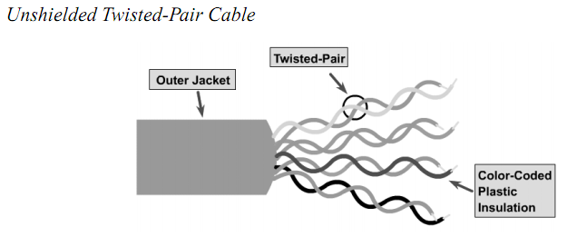
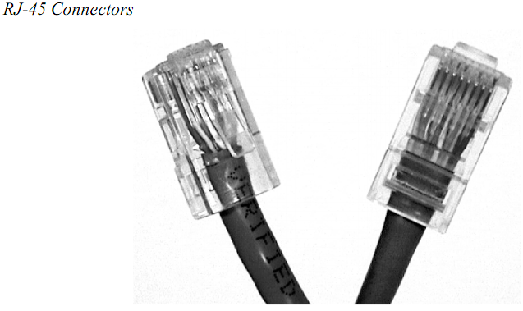

Slide 8
Cont…
Shielded Twisted–Pair (STP) Cable
  combines the techniques of shielding, cancellation, and wire twisting. Each pair of wires is wrapped in a metallic foil.
  As speciﬁed for use in Ethernet network installations, STP reduces electrical noise both within the cable (pair-to-pair coupling, or crosstalk) and from outside the cable (EMI and RFI).
  STP usually is installed with STP data connector, which is created especially for the STP cable.

Slide 9
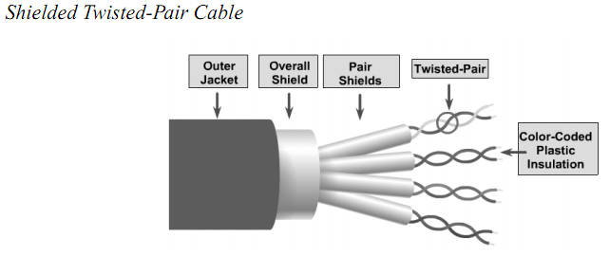

Slide 10
Types of Network Media Cont…
Coaxial Cable
  Commonly known as “Coax” , is widely used in cable TV.
  supports 10 to 100 Mbps and is relatively inexpensive, although it is more costly than UTP on a per-unit length. However, coaxial cable can be cheaper for a physical bus topology because less cable will be needed.

Slide 11
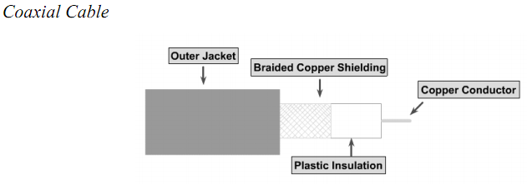

Slide 12
TWO TYPES OF COAXIAL CABLE
Thick Coaxial Cable (Thicknet)
  The largest diameter (1 cm) was speciﬁed for use as Ethernet backbone cable because historically it had greater transmission length and noise-rejection characteristics.
  can be too rigid to install easily in some situations because of its thickness.
  The general rule is that the more difficult the network medium is to install, the more expensive it is to install.

Slide 13
TWO TYPES OF COAXIAL CABLE
Thin Coaxial Cable (Thinnet)
  It has a diameter of only 0.35 cm was used in Ethernet networks.
  Thinnet was especially useful for cable installations that required the cable to make many twists and turns. Because it was easier to install, it was also cheaper to install. Thus, it was sometimes referred to as Cheapernet.

Slide 14
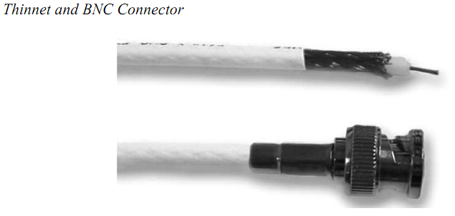

Slide 15
FIBER – OPTIC CABLE
  is technologically advanced as compared to the twisted-pair wire and the coaxial cable. Instead of transmitting frequencies, it transmits pulsating beams of light. Since, light travels much faster than electricity, fiber-optic cable can carry a greater volume of data. Also immune from electromagnetic interference which is a problem for copper-based medium.

Slide 16
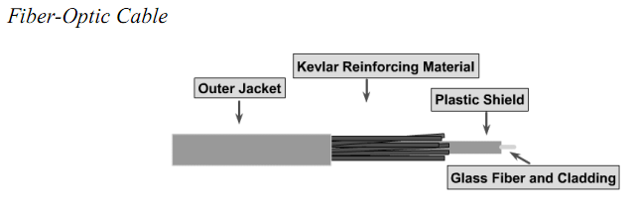

Slide 17
WIRELESS COMMUNICATIONS
  uses radio frequencies (RF) or infrared (IR) waves to transmit data between devices on a LAN. For wireless LANs, a key component is the wireless hub, or access point, used for signal distribution.

Slide 18
WIRELESS LINKS
  These are instances when the use of coaxial cable, fiber-optic cable or twisted-pair wire is impossible or impractical.
  If the place is very far apart or are blocked by natural occurring or man-made obstacles, the solution is to use wireless links.

Slide 19
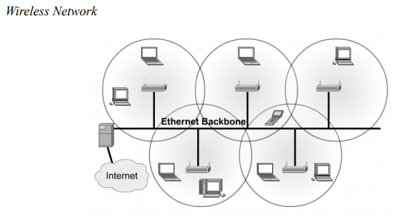

Slide 20
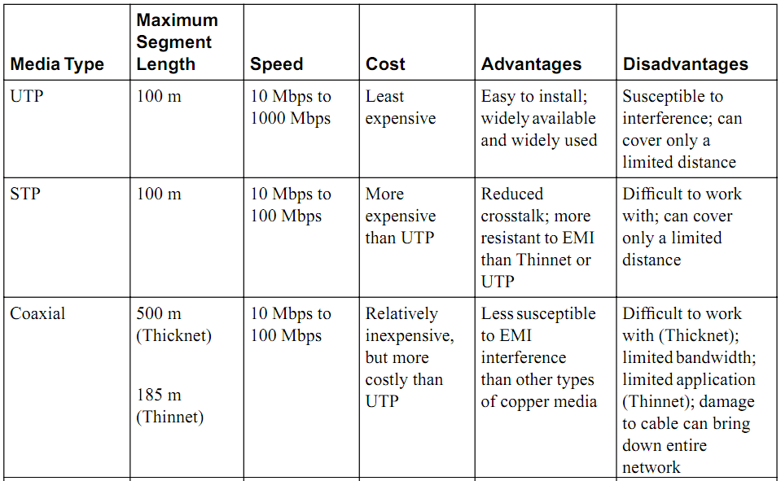
MEDIA TYPE COMPARISON

Slide 21
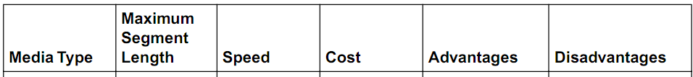
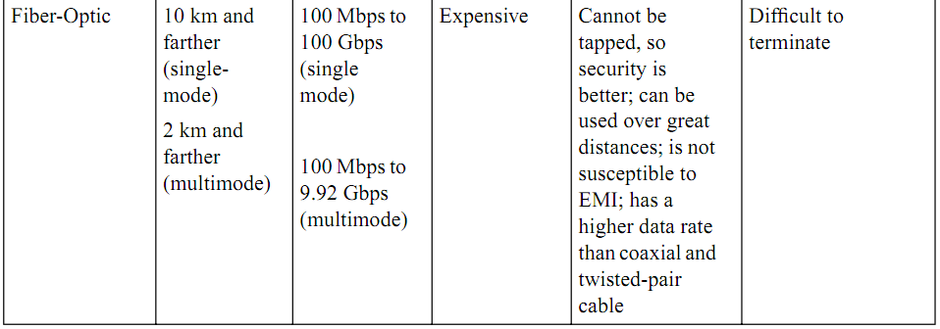

Slide 22
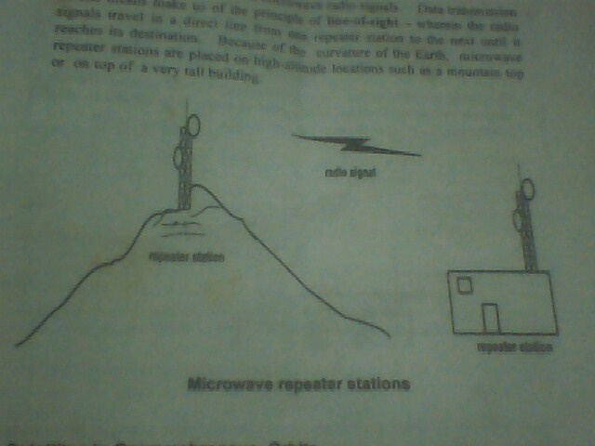
MICROWAVE RADIO SIGNALS
data can also be transmitted via microwave radio signals. Data transmission of this means make us of the principle of line of sight.

Slide 23
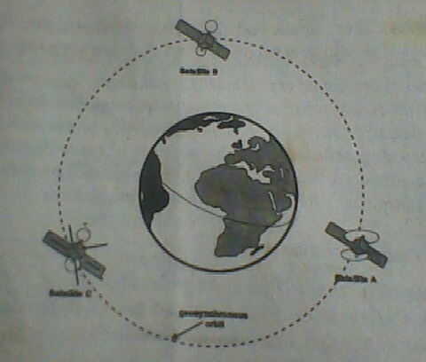
SATELLITE IN GEOSYNCHRONOUS ORBITS
Geosynchronous orbit permits the communications satellite to maintain a fixed position relative to the surface of the earth.

Slide 24
DATA COMMUNICATION HARDWARE
Components:
Modem (Modulation, Demodulation) – convert the computer signals to the telephone’s analog signals and vice versa.
Down line Processors – used to collect data from low-speed devices such as terminals and serial printer.

Slide 25
DATA COMMUNICATION HARDWARE
Front end Processors
- relieves the host processor of tasks related to data communications such as message routing, encryption and decryption of data etc.
Source – the terminal sending a message or data.
Destination – the one receiving the message or data.
Handshaking – the task of linking the source and destination.

Slide 26
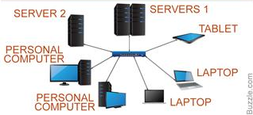
TYPES OF COMPUTER NETWORK
LAN (Local Area Network) – refers to the computers that are relatively near each other and connected by wires or wireless link.

Slide 27
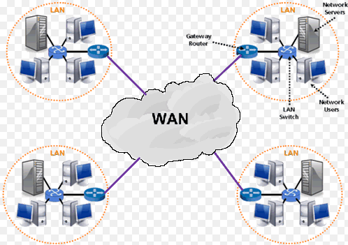
TYPES OF COMPUTER NETWORK
WAN (Wide Area Network) – typically composed of several LANs which are distributed over a wider geographic are such as a city, country or even continent.

Slide 28
THE CLIENT – SERVER RELATIONSHIP
Server – one particular computer is used for a specialized task of serving the needs of each node.
  The nodes(client) accesses the server in order to perform a particular function.
Peer to Peer relationship
  the nodes(individual computer) of a network can act as server

Slide 29
NETWORK TOPOLOGY
refers to the physical connection of wires that connect the nodes of the network.

Slide 30
BASIC TYPE OF NETWORK TOPOLOGY
Linear Bus Topology
  the server , the nodes and other hardware devices are connected to a single conduit or main line.
  one of the most common but it has its disadvantages. (a broken connection can bring down the whole network)

Slide 31
BASIC TYPE OF NETWORK TOPOLOGY
Star Network Topology
  the server(s) ,the nodes and other hardware devices are connected to central hub.

Slide 32
BASIC TYPE OF NETWORK TOPOLOGY
Ring Network Topology
  the server(s), the nodes and other hardware are connected in a circular chain where each node is connected to the next.
  the last node to be connected to the first node which form a ring.

Slide 33
BASIC TYPE OF NETWORK TOPOLOGY
Hybrid Network Topology
  the other types of topologies are combined to form a combination or hybrid topologies.
  usually used to connect the different floors or rooms of a building.

Slide 34
NETWORK PROTOCOLS
  refers to the set of rules or standards designed to enable computers connect with one another and to exchange the information with as little errors.

Slide 35
THREE EXAMPLES OF PROTOCOLS
Ethernet
  one of the most widely used network protocol
  it is simple and inexpensive to use
  it makes use of the linear bus topology

Slide 36
THREE EXAMPLES OF PROTOCOLS
Token Ring
  an IBM network Protocols which is based on the ring topology.
  token ring network transmit the electronic address of each node on the network many times per second.

Slide 37
THREE EXAMPLES OF PROTOCOLS
ARCNET
  is based on the star or distributed star topology, but it has a topology and protocol of its own.

Slide 38
Questions?

